Slide 1
Community Emissions Reduction Program
Introduction to Strategies
El Centro-Heber-Calexico Corridor
Community Steering Committee Meeting #5
February 13, 2019

Slide 2
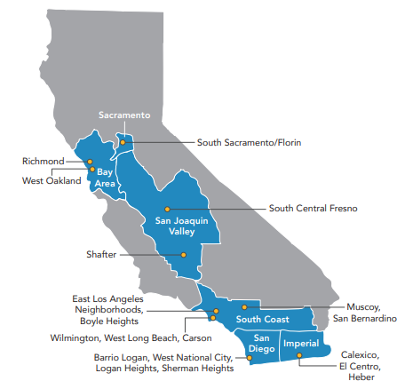
Community Nomination overview
El Centro-Heber-Calexico Corridor
Year 1 Community
Community Monitoring Plan
Community Emissions Reduction Program

Slide 3
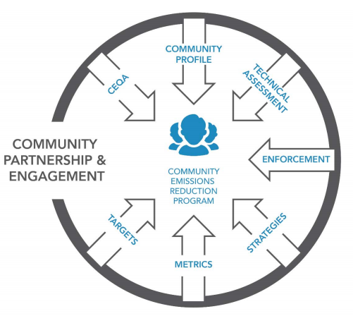
Community Emissions Reduction Program
Required Elements
“Community emissions reduction programs should include new strategies to address air pollution from stationary, mobile, and area-wide sources that contribute to the cumulative emissions and exposure burden.”
- CARB Blueprint, Appendix C

Slide 4
Potential Approaches
Emission Reduction Strategies
Complementary Strategies
Regulations / Policies
Enforcement
Incentives
Outreach & Education
Exposure Reduction
Monitoring
Public Information
Collaborations
Emission Reduction: Decrease in the amount of pollutants discharged from a specific source (e.g., a tailpipe or facility stack)
Exposure Reduction: Decrease in the amount of pollutants that people inhale

Slide 5
EmissioN Reduction Strategies
Regulations and Policies
Examples:
Rule 420 (Beef Feedlots)
Rule 701 and Policy 34 (Agricultural Burning)
Rule 805 (Paved and Unpaved Roads)
Pros:
Applies to all applicable facilities/activities of that type in Imperial County
Permanent emissions reductions
Enforceable
Cons:
Lengthy process (i.e., emission reductions may take time)
Presentation later this evening!
Notes:
Rules/regulations are like local laws that specify what facilities and equipment owners are required to do.

Slide 6
EmissioN Reduction Strategies enforcement
Examples:
Facility inspections
Complaint follow-ups
Pros:
Leads to increase compliance with rules
Identifies violations and leads to corrective actions
Cons:
Only applies to existing rules and permit conditions
Can be expensive and time-intensive
Presentation next month!
Notes:
Targeted enforcement can be used to address a specific air quality concern.

Slide 7
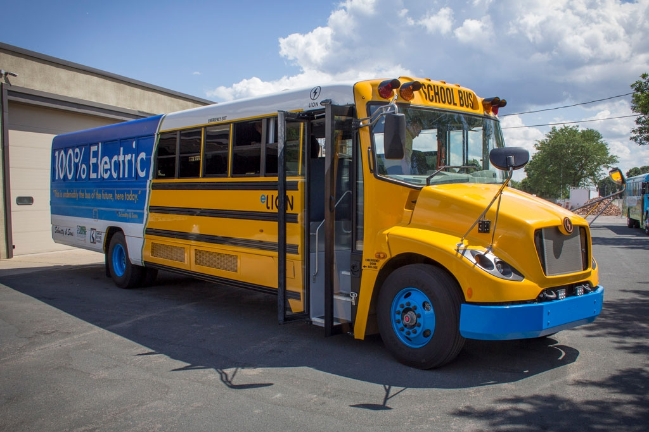
EmissioN Reduction Strategies
INCENTIVES
Examples:
Carl Moyer program
School Bus Zero-Emission Replacement Projects
Pros:
Can get equipment that is cleaner than what regulation requires
Relatively fast
Cons:
Requires dedicated funding
Funding can be competitive
Discussed during SCM #2 in December
Notes:
The purpose of incentives is to encourage equipment owners to use cleaner technologies, above and beyond what is required.

Slide 8
Additional Strategies
OUTREACH AND EDUCATION
Engage stakeholders who can help reduce emissions
Increase access to data and provide education on what that data means
EXPOSURE REDUCTION
Install air filtration systems
Plant vegetative barriers, create buffer zones
MONITORING
Collect neighborhood-level data
Identify hot spots
Track progress
Addressed in the Community Monitoring Plan!

Slide 9
QUESTIONS?

