Slide 1
Enforcement Division
Field Operations Branch
Community Outreach and Enforcement Section

Slide 2
Discussion topics
1. Responsibilities
CARB and Air District Enforcement Divisions
2. Enforcement Division Activities
3. Enforcement and AB 617
Enforcement Division role of Enforcement in AB 617
Air pollution Reports
Inspections
Notice of Violation
Remedies and outcomes

Slide 3
1. Responsibilities
Protect public health from the harmful effects of air pollution and developing programs and actions to fight climate change.
Implement and enforce Local, State and Federal Air Pollution Control Laws and Regulations applicable to Stationary Sources.

Slide 4
2. Enforcement Process
Identify and report a Potential Violation
Evaluating Information
Notify Responsible Party
Outcomes, Remedies & Penalties
Opportunity to Discuss

Slide 5
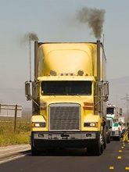
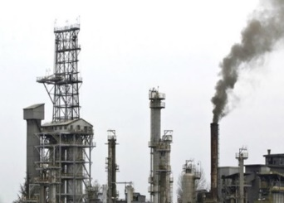
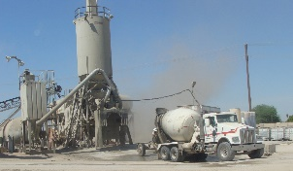
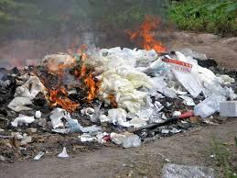
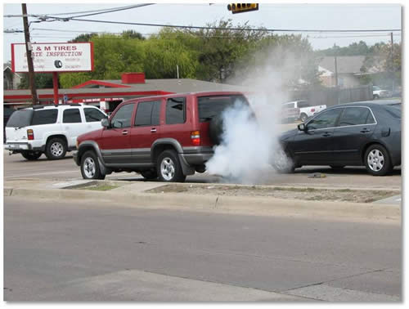
Identify a potential violation

Slide 6
Reports
Reporting potential violations of air quality requirements can provide important information for Enforcement.
https://calepa.ca.gov/enforcement/complaints/
1 (800) 952-5588
(442)265-1800

Slide 7
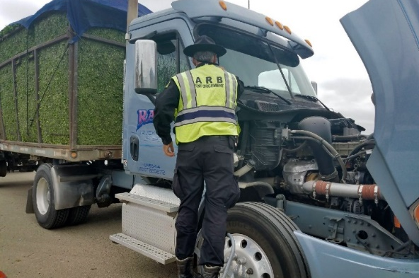
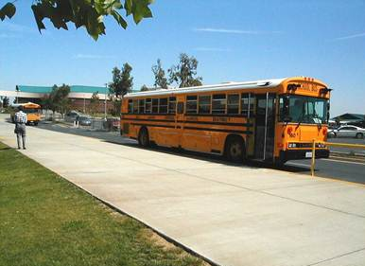
Evaluating information
Inspections: Site visits to learn about potential violations
Determine compliance status and required actions
Write Inspection Report
Issue Compliance Documents

Slide 8
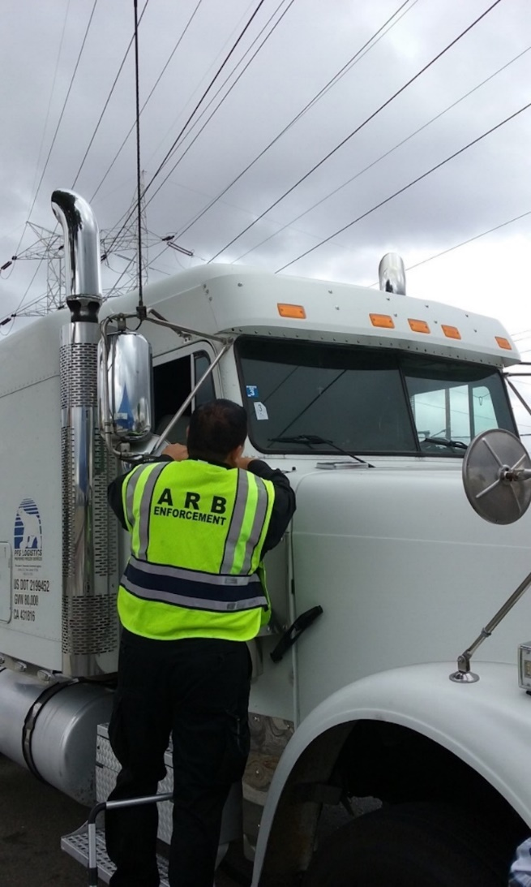
Notice of Violation/Citation
Process to notify responsible party for violations
Based on excess emissions
Listing facts, laws and regulations
Include ED contact information

Slide 9
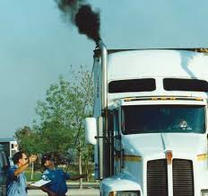
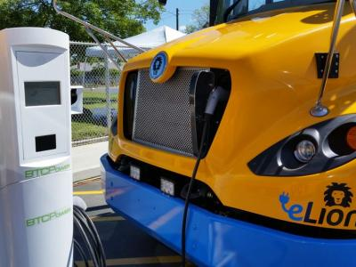
Opportunity to Discuss
Responsible party may provide further facts for consideration by CARB
Often becomes the negotiation between CARB and the responsible party

Slide 10
Outcomes/Remedies
Compliance
Appropriate pollution prevention actions
Mutual settlement / Case resolution
Penalties : Designed to remove any economic benefit from responsible party and deter future violations

Slide 11
Supplemental Environmental Projects
Community-based projects funded from a portion of the penalties received during settlement of enforcement actions.
Improve public health
Reduce pollution
Increase environmental compliance
Bring public awareness

Slide 12
3. Enforcement Division in AB 617
Community Emissions Reduction Program
Enforcement Program
Three-year look-back on enforcement and compliance within the community corridor
District and CARB are tasked with preparing this report in support of the El Centro-Heber-Calexico AB 617 Corridor
Statistics that the community steering committee can use to establish compliance goals and identify enforcement-related strategies in the emission reduction program.

Slide 13
CARB ENFORCEMENT ACTIVITIES AB 617 AREA 2015 - 2017
Fuels
Total inspections : 72
Heavy duty
Total inspections:801

Slide 14
CARB Enforcement Programs
DRAYAGE
SmartWay
IDLING
STB
OFF-ROAD
TRU
HDVIP
SERVICE STATIONS

Slide 15
ENFORCEMENT IN IMPERIAL COUNTY
How can the community enhance CARB/District enforcement efforts?

