Slide 1
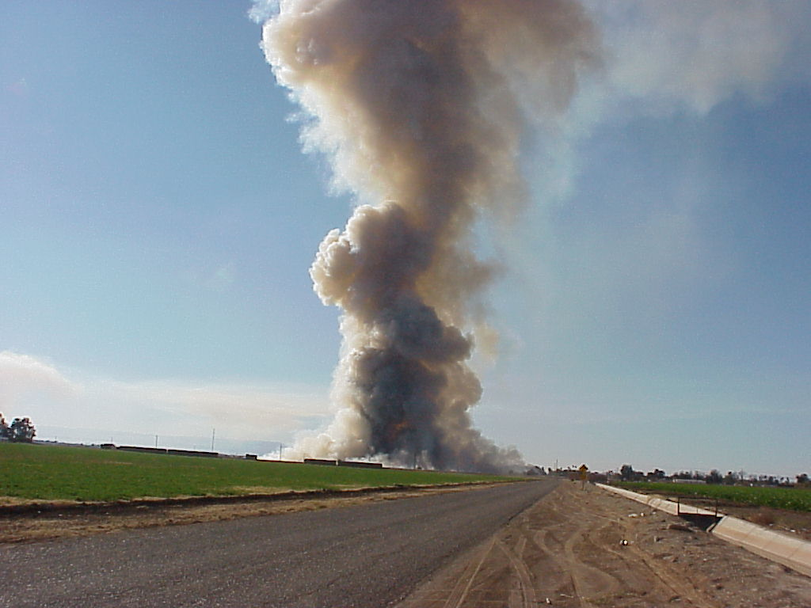
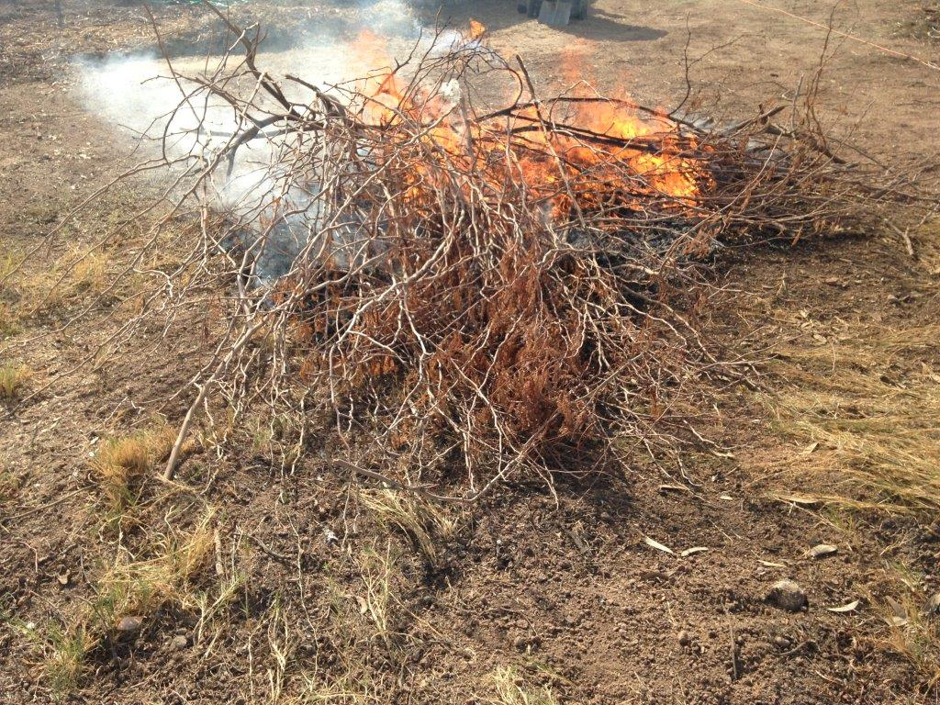
Imperial County Agricultural and Open Burn Program

Slide 2
Burn Rules, Plans & Policies
California Health & Safety Code Section 41850 gives authorization to local Air District to reasonably regulate but “NOT” prohibit Agricultural Burning. This section also requires that the Air District adopts rules and regulations for the purposes of this article.
California Health & Safety Code Section 41855 requires the State “CARB” to determine and designate dates when burning is allowed or prohibited. As such California Health & Safety Code Section 41856 required the State “CARB” to develop guidelines for the regulation and control of agricultural burning for each air basin in the state. Title 17 of the California Code of Regulations was developed to provide Smoke Management Guidelines for Agricultural and Prescribed Burning.
To address Title 17 locally the Air District has developed a Smoke Management Program which identifies the Agricultural Burn Regulations as well as Air District Policies in place.
Locally Imperial County’s Agricultural Burning is governed by Air District Rule 701- Agricultural Burning while Rule – 421 regulates Open Green Waste Burning.
The Air District’s Policy 34 focuses on the procedures for allocating burn acreage, burn day decision and tracking and Policy 37 is defined as the “Good Neighbor Policy” which focuses on providing notification of possible agricultural burns to nearby residences as well as providing traffic re-routing when necessary.
Notes:
I would like to provide you with some background as to why we authorize agricultural burning of green waste burning.
It is important to note that burning occurs throughout the State.

Slide 3
Enforcement Division Daily Weather Analysis
California Air Resources Board Meteorology Program
https://www.arb.ca.gov/smp/met/met.htm
NOAA National Weather Service
https://forecast.weather.gov/MapClick.php?zoneid=CAZ567
NOAA Air Resources Laboratory
https://ready.arl.noaa.gov/READYcmet.php
Prescribed Fire Information Reporting System (PFIRS)
https://ssl.arb.ca.gov/pfirs/cb3/cb3.php
NOAA National Weather Service Forecast Office
https://forecast.weather.gov/MapClick.php?w0=t&w3=sfcwind&w3u=1&w6=rh&w9=mhgt&w12=twind&w12u=1&w13=ft20w&w13u=1&AheadHour=0&Submit=Submit&FcstType=digital&textField1=32.82540&textField2=-115.62147&site=all&unit=0&dd=0&bw=0
CARB Aircraft Soundings (Not in Use)
https://www.arb.ca.gov/smp/met/apob.php
Imperial Valley Air Quality
http://imperialvalleyair.org/
Notes:
Here are some of the websites an inspector performing the Weather Analysis will look at. Depending on the results of the analysis he will determine if that day is or NOT a burn day.

Slide 4
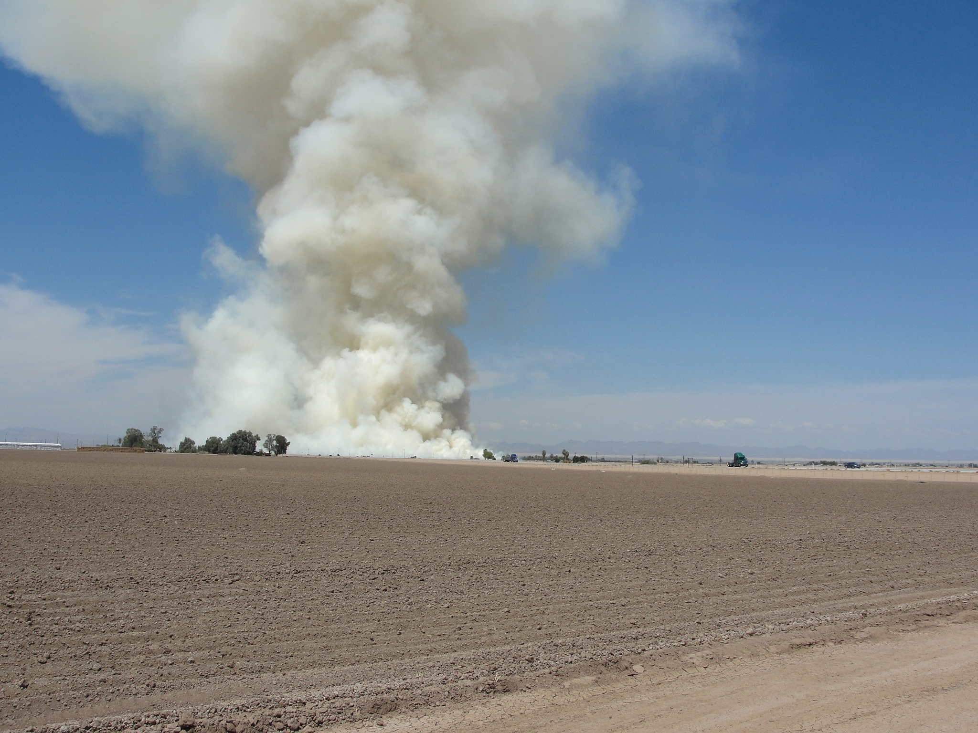
Permissive “Agricultural” Burn Days
BURN DAY: Any day on which Agricultural Burning is not prohibited by the Air Resources Board and/or the Imperial County Air Pollution Control District. Residential burns “Open Burns” are also allowed during designated “Burn Days”
BURNING HOURS: Typically between 10 a.m. to 3 p.m. but will be determined based on all factors that have been evaluated.
FIRE OUT: Before Sunset of each day.
REQUIREMENTS: Must have received authorization to burn field by the Air District and follow burning instructions given as well as those requirements found on Rule 701 – Agricultural Burning and Possibly Policy 37 – Good Neighbor Policy.

Slide 5
Marginal Burn Days
MARGINAL DESIGNATION: A day when limited amounts of agricultural burning, including prescribed burning is not prohibited by the State. Typically throughout the year we burn a very small amount of agricultural acres on marginal days. Usually the only burns taking place are the Open Burns of residential green waste.
WHAT IS MARGINAL GREEN WASTE ONLY: These are days when only vegetation grown on your property can be burned at your residence. Burns must take place outside any city limits and townships.
BURN HOURS FOR MARGINAL GREEN WASTE ONLY: Typically between 10 a.m. to 3 p.m. however we will look at all factors before making determination.
FIRE OUT: All fires must be out by sunset of each day.
Notes:
I do want to mention that during the last several months the Air District has internally made it a common practice to inspect residential burn piles at specific locations in Imperial County where there is residential neighborhoods that are located just outside city limits.
We also make it a practice to inform all callers requesting to burn to utilize trash services when available instead of burning. However we know this is also problematic as landfills will lose capacity much sooner and there are upcoming regulations that will potentially prohibit this from being an option.

Slide 6
Weather Report Process
Burn Day
No Burn Day
Miscellaneous Burn Day
Marginal Green Waste Only
Ag. Fields
Marginal Green Waste Only
Weather Report
Notes:
Here is a quick view of what it all comes down to. Depending on the weather analysis the inspector in charge of the weather will select the condition to burn or NOT burn.

Slide 7
Example of “NO Burn” Day Designations by CARB
Based on best available information on each day, the Air District made a determination not to burn on 21 days in December 2018. Most were due to either rainy days, bad air quality, low inversions, length of time available to burn and holidays.
Notes:
Although CARB makes their burn designation for each day based on evaluation of weather patterns, air quality, modeling, forecast and other factors, the Air District still evaluates all up to date available data during the morning or each day in order to make an educated designation. The Air District will hardly ever burn on a “No Burn” day designated by CARB unless the Air District is completely comfortable in making the change based on up to date data. Nevertheless, the Air District will call a No Burn Day when up to date data demonstrates it is not a good burn day even if CARB has designated the day as a burn day.

Slide 8
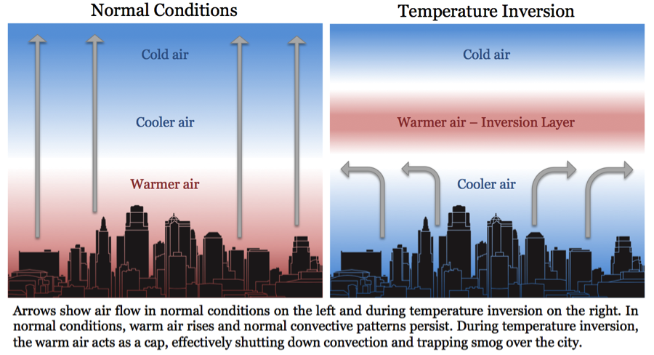
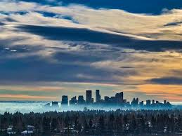
Winter Inversions
In wintertime, a temperature inversion occurs when cold air close to the ground is trapped by a layer of warmer air. As the inversion continues, air becomes stagnant and pollution becomes trapped close to the ground.
Notes:
Winter inversions are very common in the Imperial Valley and we often see them early in the morning when we wake up. Unfortunately due to our geographical landscape as well as stagnant wind conditions these inversions tend to occur regularly in the valley. This plays a major role in the Air District’s decision when it comes to burning.

Slide 9
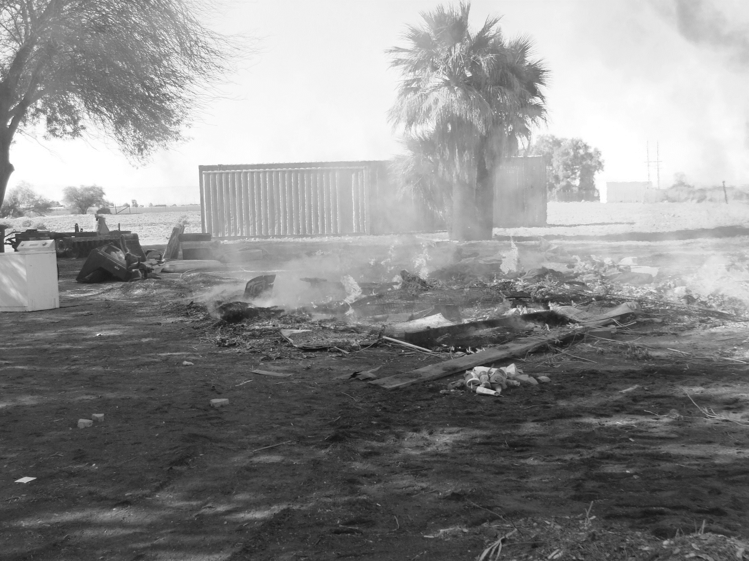
Illegal Burn
BURN BARREL AND/OR INCINERATORS (Not allowed) Effective January 1, 2004.
BURNING HOUSEHOLD TRASH: Except as otherwise provided herein, no Person shall use Open Outdoor Fires for the purpose of disposal or burning of petroleum wastes, demolition debris, tires, tar, trees, wood waste, trash or other combustible or flammable solid or liquid waste; or for metal salvage or burning of Motor Vehicle bodies. (Rule 421 B)
Notes:
California Air Resources Board (CARB) Has adopted a Statewide rule restricting the burning of household waste at residences, effective January 1, 2004.
55 gallon metal drums and/or Incinerators are prohibited Statewide.
Proper disposal must take place, either by self-hauling to a transfer station, landfill, or recycling center. (See Fact Sheet or Burning Residential Waste Tri-fold Brochure)

Slide 10
Imperial County Aerial Map 500 Agricultral Acres Max Per Quadrant
CA-78
CA-111
Notes:
Let’s imagine today is a burn day and we must select some fields to burn. The inspector in charge will strategically select the field based on the location, wind direction, wind speed and surroundings (Cities, Schools, Hospitals, etc.) Once all that has been identified, you will determine the starting time and how many acres you will be burning per each quadrant. (Not to exceed 500 acres per quadrant).
Our dividers are CA Hwy 78 and CA Hwy 111.
The green dots represent our five (5) Regulated Air Monitoring Stations.

Slide 11
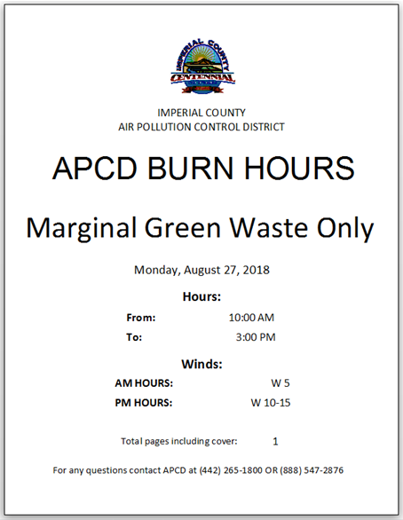
Cover page faxed to ICFD/Others
Notes:
Here are some examples of what gets submitted to the Fire Departments and other agencies:
Cover Page:
Burning conditions
Date
Burning Hours and
Wind Direction.
Followed by a Ag. Field List and/or Marginal Green Waste Only List.
Burning information is also now available on the Air Districts website.

Slide 12
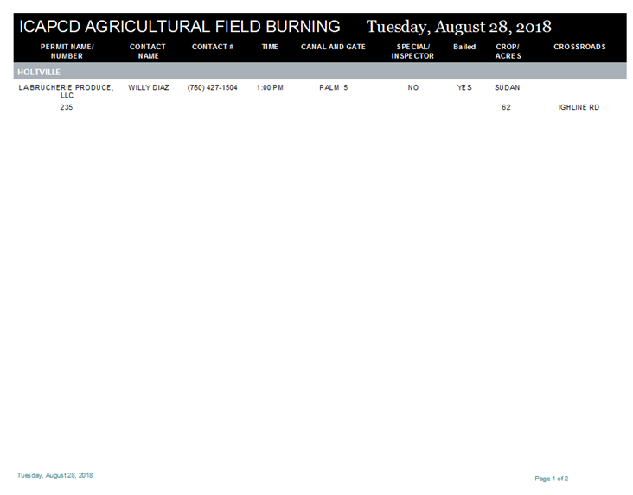
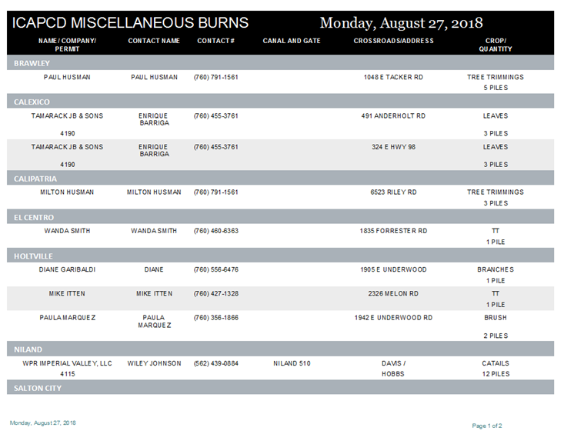
Ag. and Miscellaneous page faxed to ICFD/Others
Notes:
Here are some examples of what gets submitted to the Fire Departments:
Cover Page:
Burning conditions
Date
Burning Hours and
Wind Direction.
Followed by a Ag. Field List and/or Marginal Green Waste Only List.

Slide 13
Total Agricultural Fields Burned Per Year & Total Number of Fields Participating in ERC Program
Notes:
As you can see in this graph, there has been a significant decrease of Agricultural Burns in Imperial County over the last several years. Furthermore the table below also demonstrates that farmers are utilizing the ERC program instead of burning their fields. Actually over the last few years, the number of acres participating in the ERC program is larger than the amount of actual acres burned.

Slide 14
Thank You
Contact Information
Emmanuel Sanchez
APC Division Manager
Imperial County Air Pollution Control District
emmanuelsanchez@co.imperial.ca.us
(442)265-1800

